Slide 1
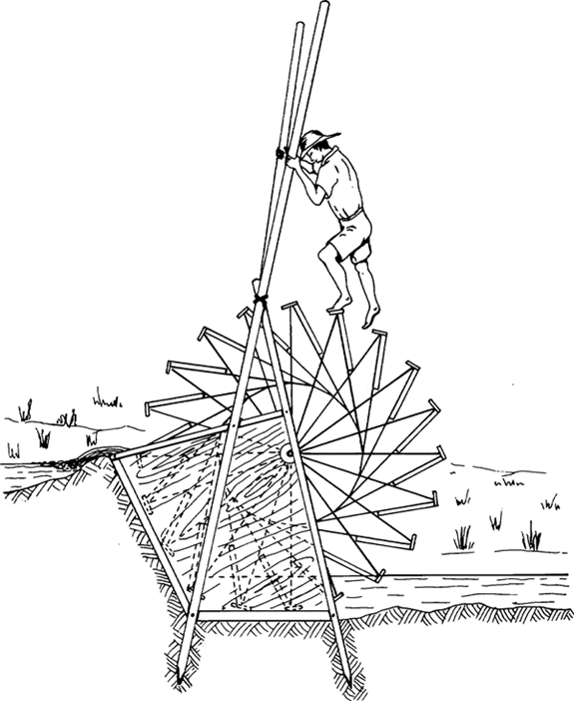
Environment and Development: A Political Ecology Understanding & Case of Vembanad Lake
NC Narayanan
IIT Bombay

Slide 2
Today
Ethical and Political Economic Critique of Western Industrial Model
Sustainable Development
Political Economy to Political Ecology
Illustration through Case of Lake Vembanad

Slide 3
Is environmentalism a first world luxury?
Aldous Huxley: “Wordsworth in the Tropics”
The worship of nature came easily, almost naturally , to those who lived “beneath a temperate sky and in the age of Henry Ford”
G.M. Trevelyn (Cambridge): “Their (British) separation from natural world enforced by urban living fostered a yearning to return for short spurts to nature. And for that if for no other the real country must be preserved to satisfy the soul’ds thirst of the town dweller”
Chenchu community (AP): “If you love tigers so much, why don’t you shift all of them to Hyderabad and declare the city a tiger reserve”?
(Guha and Alier, 1997)

Slide 4
Environment and Development– Ethical/Political Economy Critique of western industrial Model

Slide 5
Western Development rests on ‘extractive exploitation’
Expansion of the Empire and the Environmental Toll
Drain Theory-Dadabhai Naoroji
Dependency Debate
A Continuation of Colonial Extraction
Mining in Contemporary India

Slide 6
Understanding of ‘Progress’
Domination of nature solely for the benefit of homo-sapiens
Reducing ‘nature’ to ‘natural resources’ : valuing nature for its ‘usefulness’ (instrumental value) and ignoring the ‘intrinsic value’ – neglect the needs of non-human species and life forms.
Deforestation for plantations/agricultural production,
Mining ores: Trees and Hydrology
Dams ‘saving water from losing to the sea’
“Seeing Like a State”– James Scott

Slide 7
Prioritises Economic Growth
Stimulates Consumption; Threatens resource base for future development
Assumes environmental deterioration as an inevitable consequence of development
Accepts the ‘trade-off’ or exchange between economic development and environment
In the west- technical efforts to address ‘pollution’ . Energy foot print of ‘technical fixes’ like waste water treatment and SWM???)

Slide 8
Assumes Consumption as the most important contributor to human welfare
Measuring welfare by means of ‘standard of living’—ie amount of disposable income to purchase goods & services
A model Based on individualistic consumption at the expense of social good. Increases inequality.
Contrasted to ‘quality of life’ – refers to the collective-enhancing the quality of the public domain such as provision of public education, health care and environmental protection.
Deterioration of natural environment causes social disruption and impairs human health

Slide 9
Global replication of resource-intensive lifestyle of west needed/inevitable?
Impossible to achieve a of the high-consumption economies of the North
Not enough natural resources, including water, to support such development.
Planet’s ecosystem cannot absorb the resultant pollution, as witnessed by climate change.
The model of development pursued by Western industrial societies cannot be carried into future,.

Slide 10
Sustainable Development

Slide 11
Sustainable Development &Conflicts Within
SD: Satisfying needs of present without compromising the ability of future generations to satisfy theirs.
“What” Needs? “Whose”Needs?
Between:
the present and future generations
human well-being and the protection of nature
the poor and rich
a local and a global focus: ‘Here’ and ‘Elsewhere’

Slide 12
Importing Wealth and Exporting Un sustainability: Case of Netherlands
Largest per capita consumer of tropical timber in the world: 1,112,000 m3 in 1999. Out of this 50% is originating from illegal logging.
Fodder import: To feed 13 million pigs, 4 million cattle and over 100 million chickens:
International transfer of nutrients: soya bean from Brazil by deforestation in Amazon. Capital-intensive production: give little benefits for the peasants.
Import of oil palm from Indonesia 1.5 million tonnes-- heavy deforestation including forest fires by companies. In 12 years (1985-97), 17 million ha of tropical forests have been lost, equivalent to 25% of the total Indonesian forest cover in 1985
Source: Compiled from IUCN (2002)

Slide 13
Importing Wealth and Exporting Un sustainability: Case of Netherlands
500 million kg of fish land in NL, out of which 90% is exported., especially from west Africa.: Over exploitation of the seas by foreign fleets seriously threatens the marine ecosystems, drive local populations into malnutrition and poverty and leads to serious loss of biodiversity
NL imports 20,000 tonnes of shrimp annually for processing and export: destroyed wetland, converted paddy fields and damaged the coastal areas in countries in Asia, South America and Africa.
Imports of oil, coal, gas and electricity increased 23% during 1995-2000. About 50% of this is used for export purposes. The heavy chemical and metal industries as well as agriculture and transport sectors are especially energy intensive.
NL exports large amounts of pesticides and chemical wastes to developing countries

Slide 14
Dimensions of Development
ECONOMIC
POWER
SD
SOCIAL
ENVIORNMENTAL
SD: Field of Sustainable Development

Slide 15
Political Ecology

Slide 16
Political Ecology
Political Economy
Political Economy to Political Ecology
Nexus of Production Relations

Slide 17
Political Economy: Agrarian Studies
People-People Relations and not only People-Nature
Unequal access to land & agricultural inputs
Agrarian change: commercialisation, accumulation, differentiation
These relations directly or indirectly affect land using decisions & lead to environmental degradation.
Involve identification of different economic interests.

Slide 18
Surplus Extraction
By government/land lords – to finance their conspicuous consumption and military aristocracy.
Was Socialist experience different?
Pressure on production – Green Revolution/ Industraial. Agrl.
Simple reproduction squeeze – deterioration of terms of trade between purcased inputs (from industry) and price of commodities sold by farmers
Who produces, who controls exchange, Who appropriate surplus?
Leads to exhaustion of land/labour

Slide 19
Confluence of political economy and political ecology
PE deals with economic distribution conflicts
Political ecology: Add Ecological distribution conflicts
Dependency --‘core-periphery relations’.
Concept of ecologically unequal exchange -- extractive economies (pressured to exporting primary products). create poverty and ED simeltaniously at the local level.
Expansionary Tendency of Capital and patterns of the (global) capitalist system - E.g.Logging, mining, fishing, contract farming

Slide 20
NRP – Nexus of Production Relations
Social relations of production--ownership of means of production.
GR produced higher yields, but conferred benefits unequally to different classes
Economic essentialism Challenged & Extended to:
Cultural relation of production interaction of production with the way of life (economy vs. culture).
ERP –ED is more detrimental to eco-systems people.
ARP – Academic descriptions are not impartial, value-free and non-political

Slide 21
Highlights
NRM in historical, socio-economic and political context. Root cause of ED: class structure and power relations.
Social relations and NOT society-nature relations
Surplus Extraction & ‘Pressure of production’ leads to – ED & Social marginalistion (NOT “population pressure”)
Nexus of production relations
Environmentalism and struggles of poor in NPR which can be anti-state as well.

Slide 22
Political Ecology =Economic Vs Social-Environmental
Economic Growth leading
to
Twin processes of
Environmental Degradation
and Social Marginalisation

Slide 23
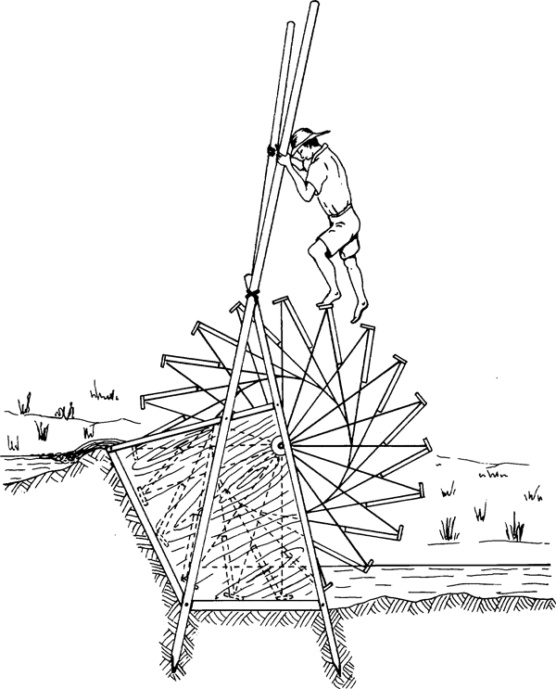
Green Revolution to Tourism and Deepening Environmental Crisis in Lake Vembanad

Slide 24
Structure
Rice-Centric Development of Lake Vembanad
Environmental Externalities of Green Revolution
Tourism and its Impacts: Political Economy of Pollution
Learnings

Slide 25
Lake Vembanad
Largest body of brackish water in South India: covers an area of over 1512 km-- approximately 4% of Kerala
Water and rich silt via four rivers from the east.
Tidal influence from the Arabian Sea.
Rice cultivation and flood control initially by private farmers: ‘Wasteland reclamation’ and enclosure of commons
II World War - constriction of rice supplies
Evolved into a ‘rice bowl’ controlled by powerful landowner interests with State support.
1970s--‘Green Revolution’: HYV, fertilisers, pesticides
Need for Double Cropping & Two Engineering Interventions

Slide 26
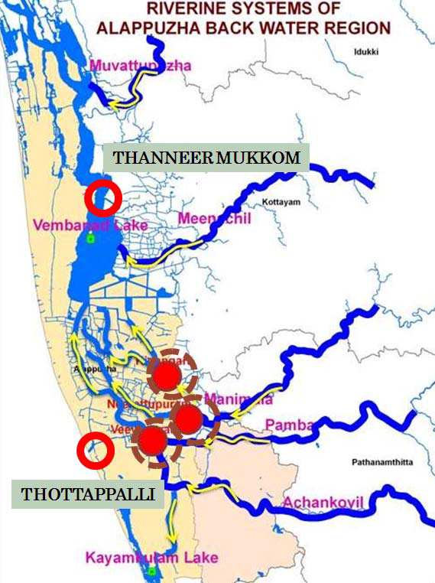

Slide 27
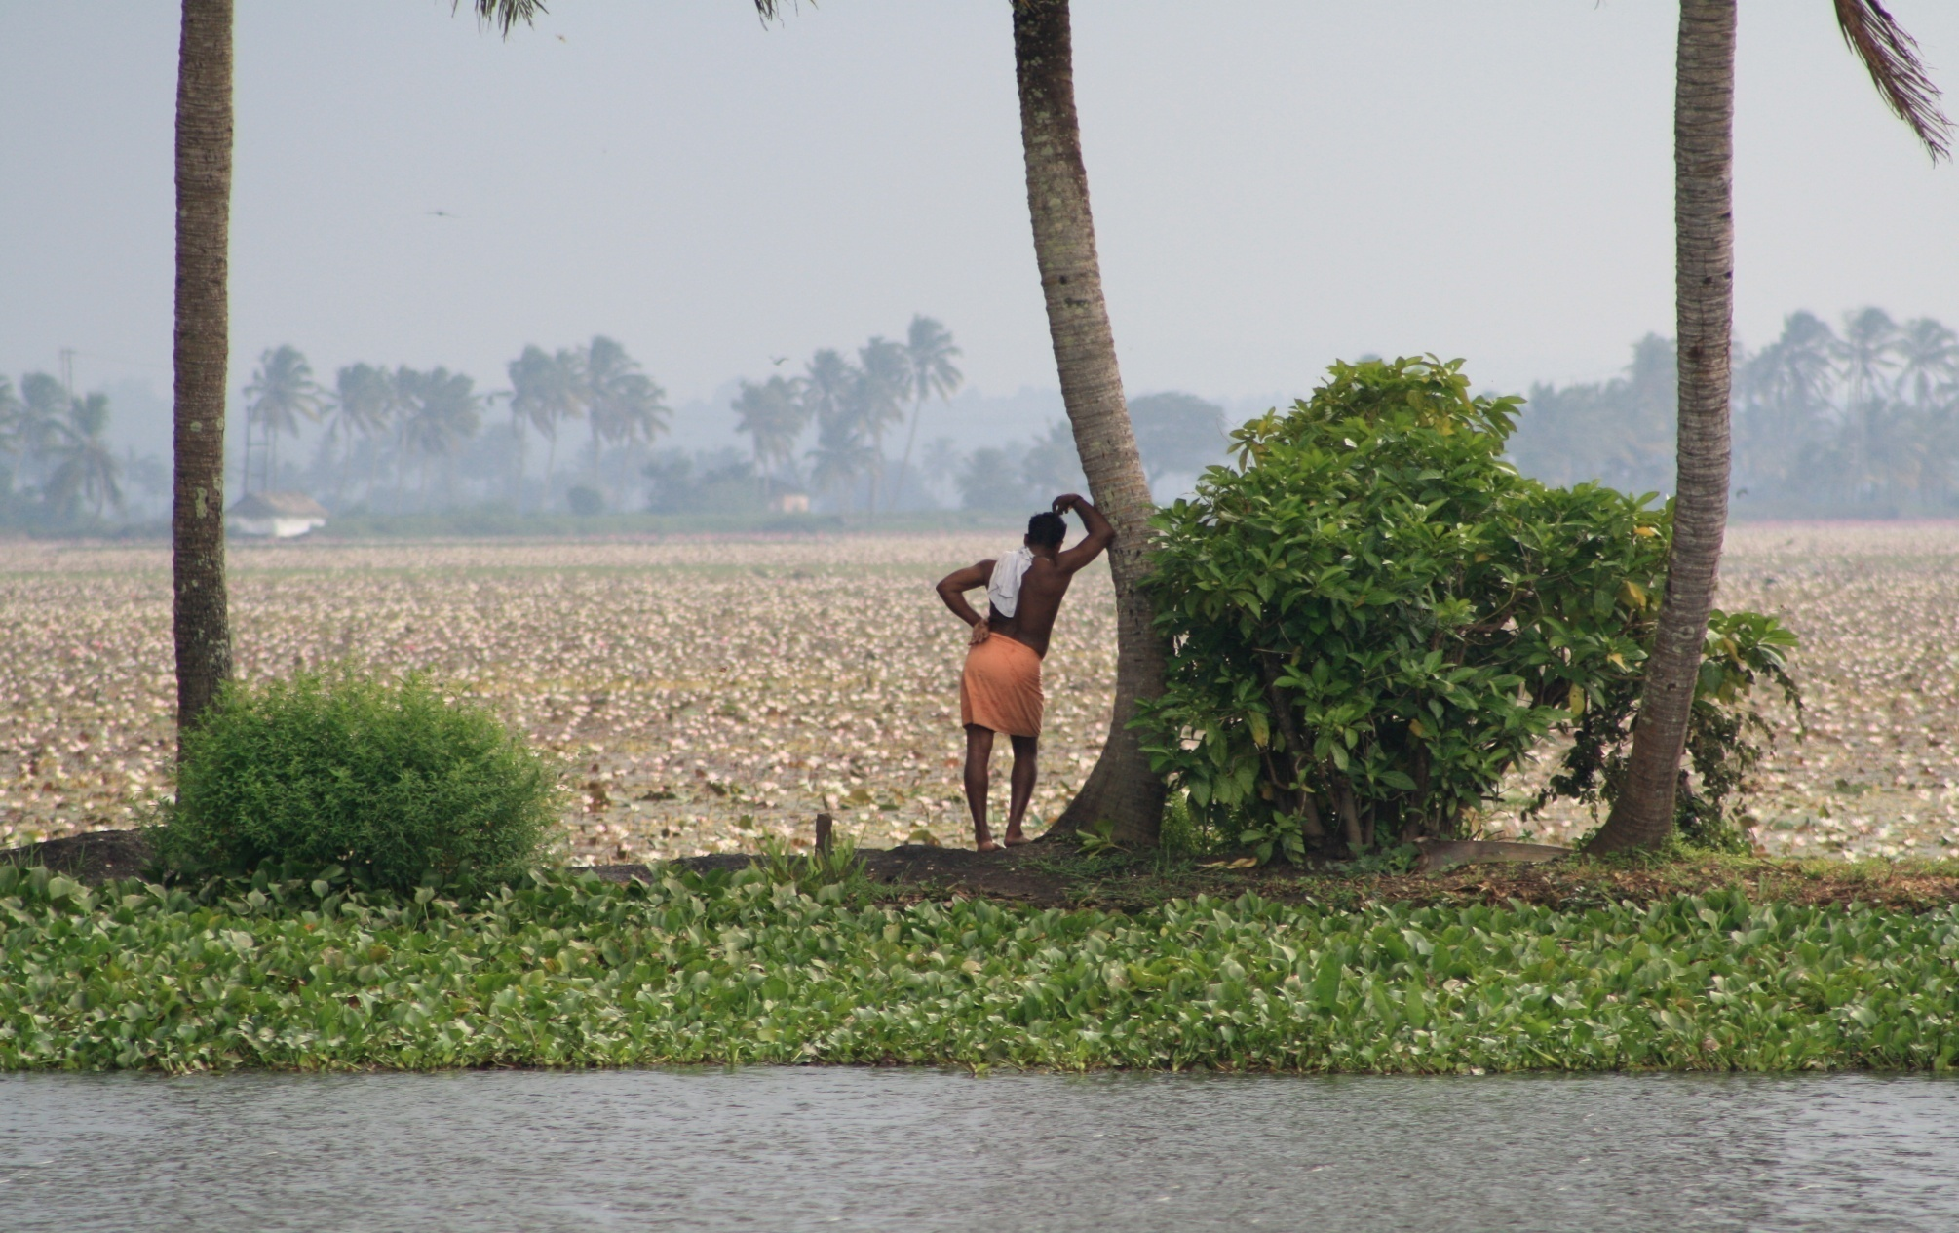
Rice fields below sea level

Slide 28
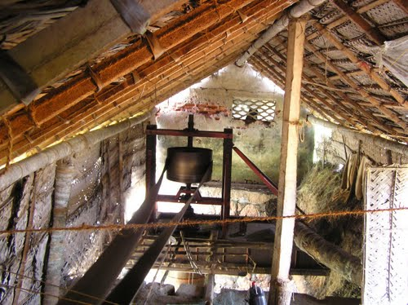
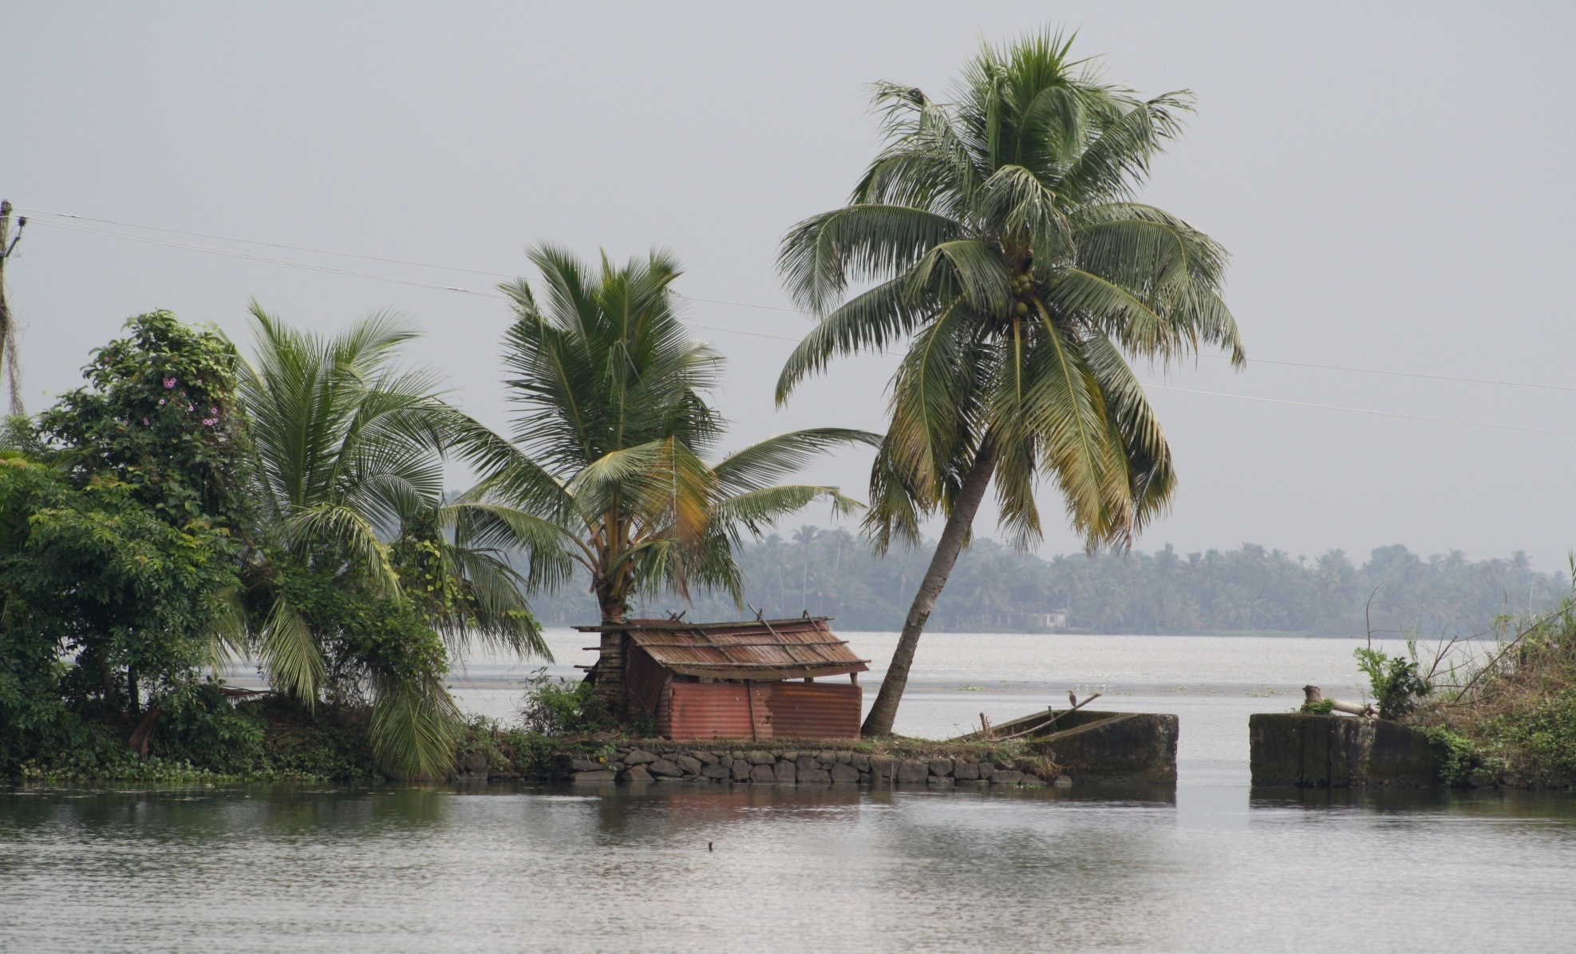
Levees (polders), pumping stations

Slide 29
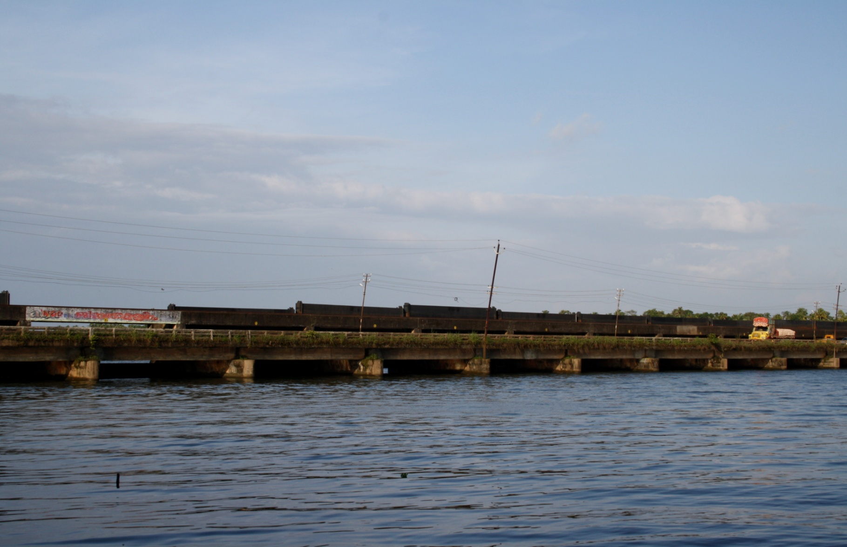
Lake Vembanad: the salinity barrier

Slide 30
Implications
Salinity: as ‘pollution’.
Engineering of the lake…. A spillway to drain off floodwaters, and a regulator (barrier) to check the incursion of saline water.
Conflict with fisherfolk
Vembanad is an extensive nursery for marine prawns, with centuries-old fishing traditions.
consumes about 20000 tons of Fertilizers per year and also a large amount of agrochemicals and pesticides
Residues pollute water that is pumped into the canals and used for daily demands

Slide 31
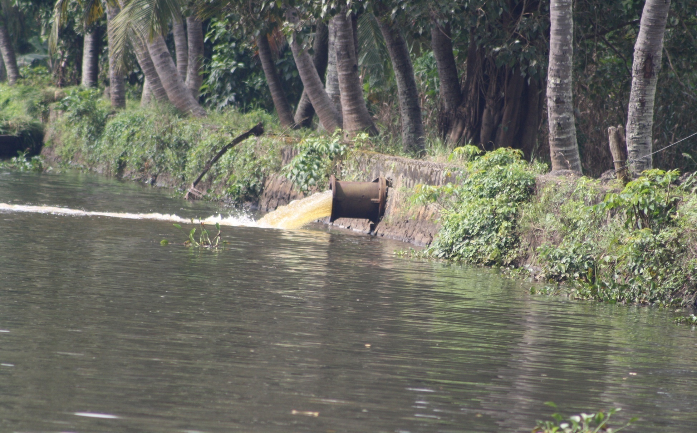
Pollution is not an ‘externality’

Slide 32
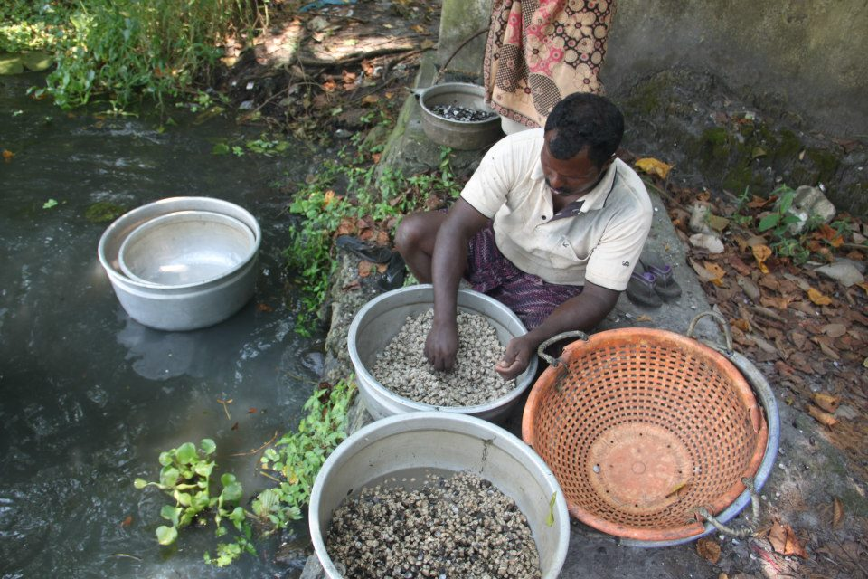
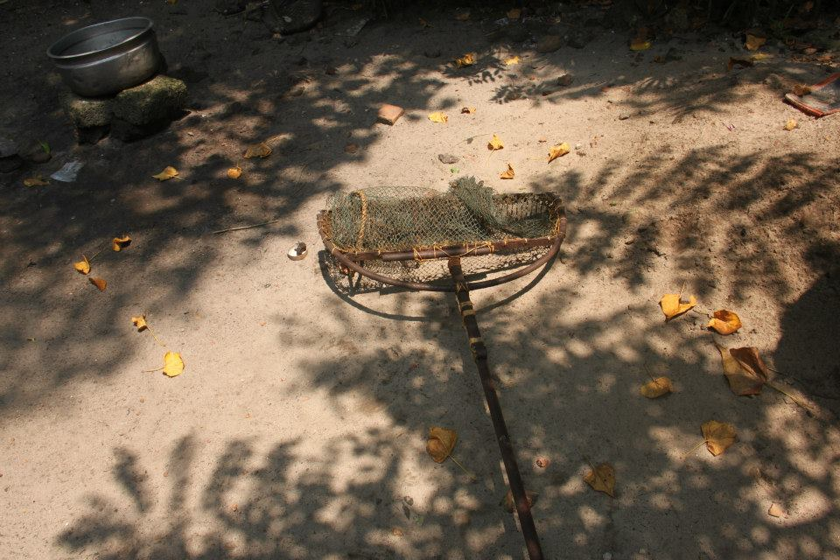
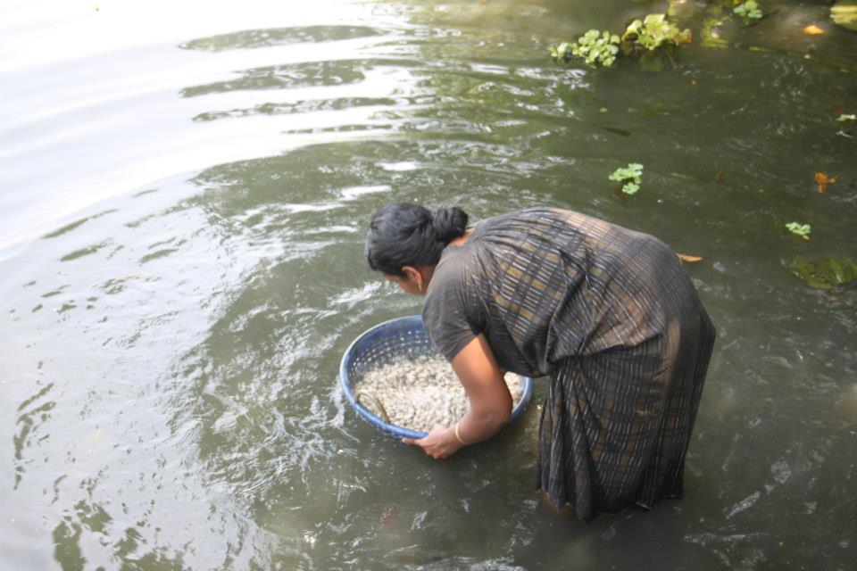
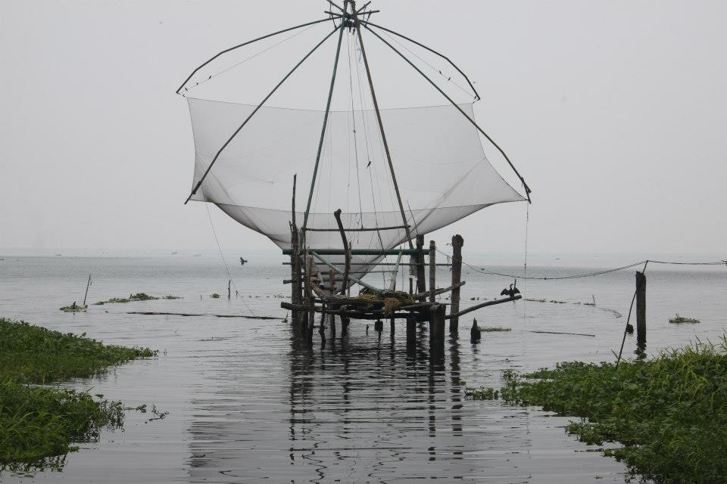
Impact on Fisheries

Slide 33
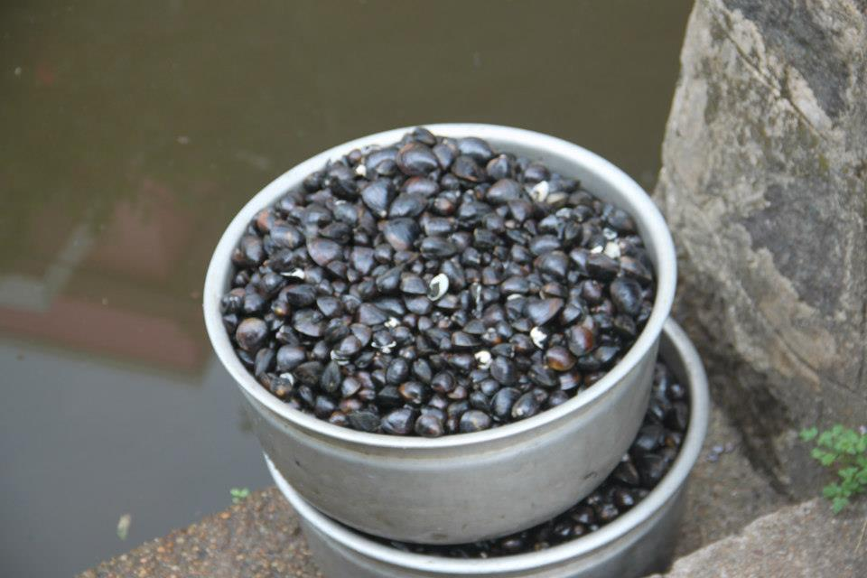

Slide 34
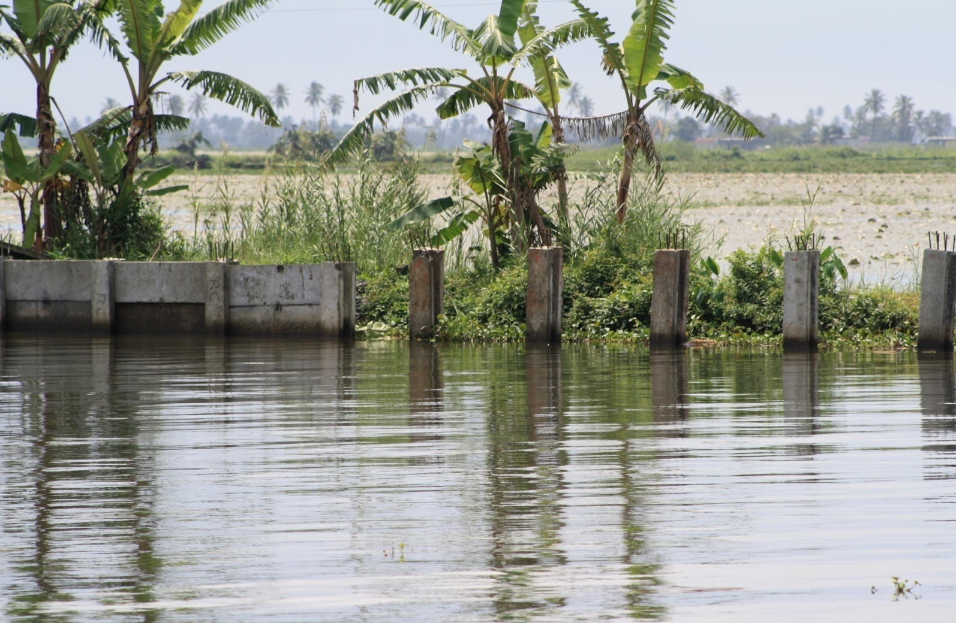
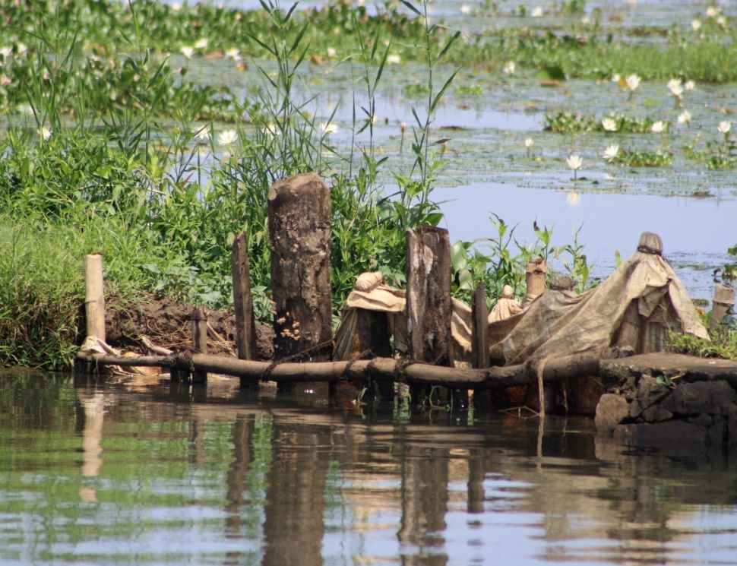
Levee (Bund)raising?

Slide 35
Kuttanad Package
A Central Government scheme to develop the region based on ‘project proposals’.
Majorly projects are oriented to ‘water resources development’ from the Ministry of Water Resources
Reduced to Outer Bund Building
Legitimised by integrating this with farm roads ( 3m wide)
Interests of bund builders, farmers and real estate developers have coalesced here.
Does not match with the earlier wisdom about Kuttanad ecosystem – All earlier studies had warned against fragmenting the wet land ecosystem by bund building.

Slide 36
Kuttanad Package Reduced to a Proposal for Outer Bund Construction
District | No. of Polders | Area (ha) | Length (km) | Cost (lac Rs)
Alapuzha | 829 | 34697 | 2067 | 187621
Kottayam | 445 | 17458 | 1006 | 82434
Pathanamthitta | 44 | 2303 | 130 | 11897
Kollam | 9 |  |  | 777
Total | 1327 | 54458 | 3202 | 282369
Source: KSSP, 2011: 31

Slide 37
Kuttanad Package: Material Needed For Bunding
Item | For 1 km | For 3062 km
Granite | 3000 million Cube | 9186000 million cube
Sand | 3550 Cubic Feet | 10870100 Cubic Feet
Cement | 500 Bags | 1531000 Bags
Source: KSSP, 2011: 33

Slide 38
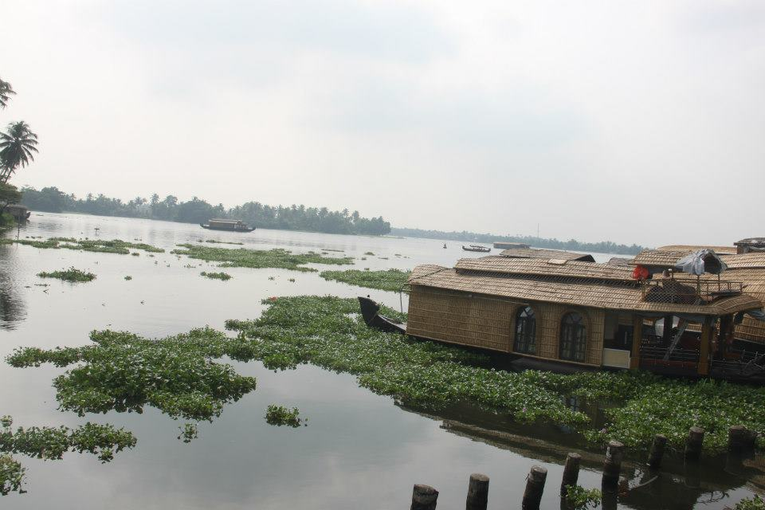
Tourism Development and Environmental Implications

Slide 39
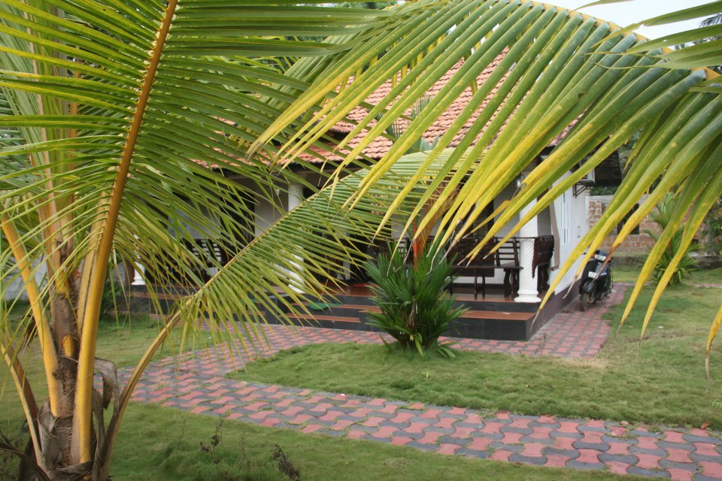
Resorts

Slide 40
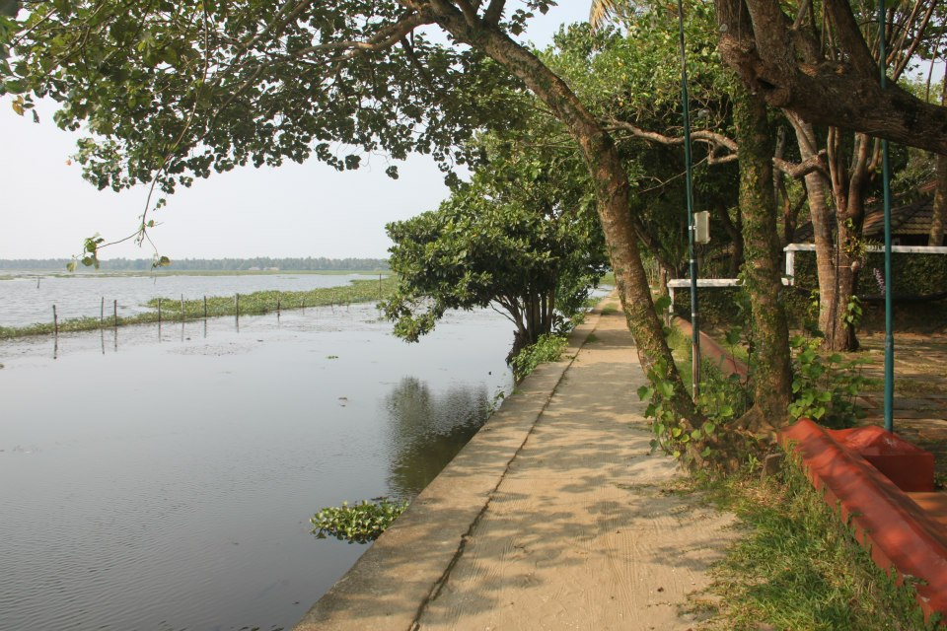
Encroachments into Lake

Slide 41
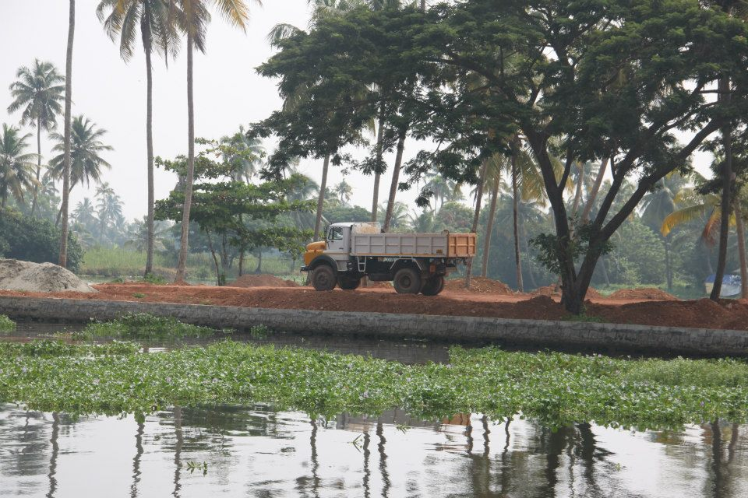
From “Wet” to “Dry” Land

Slide 42
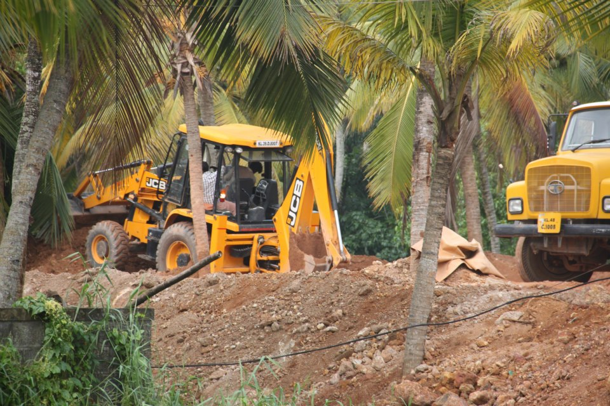

Slide 43
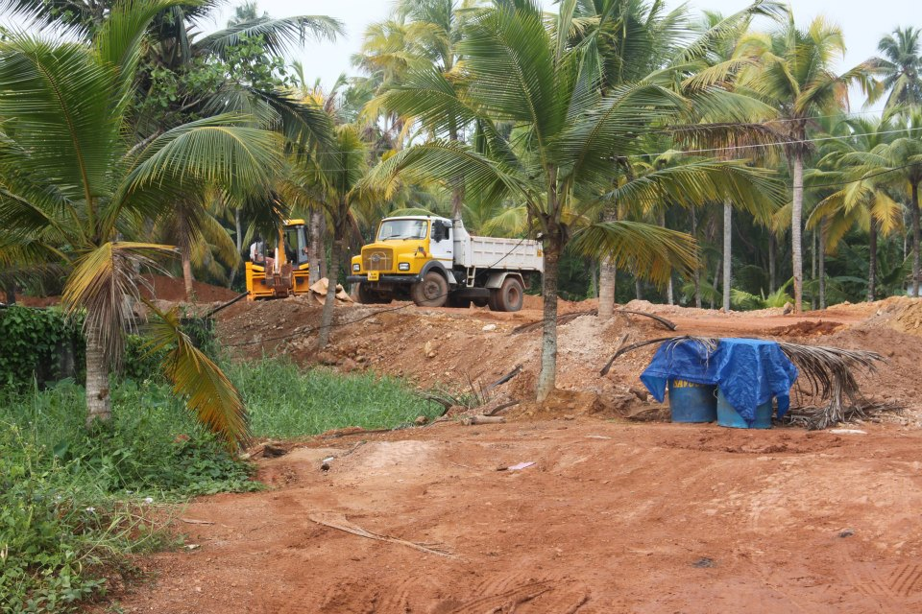

Slide 44
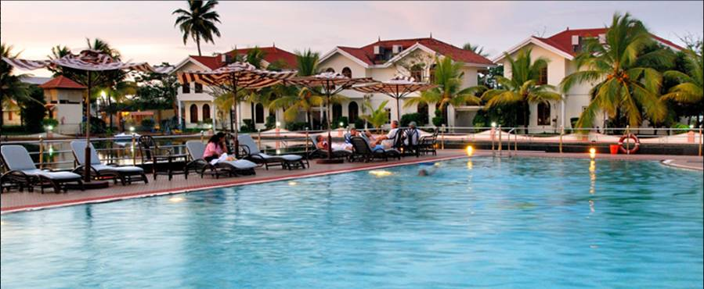

Slide 45
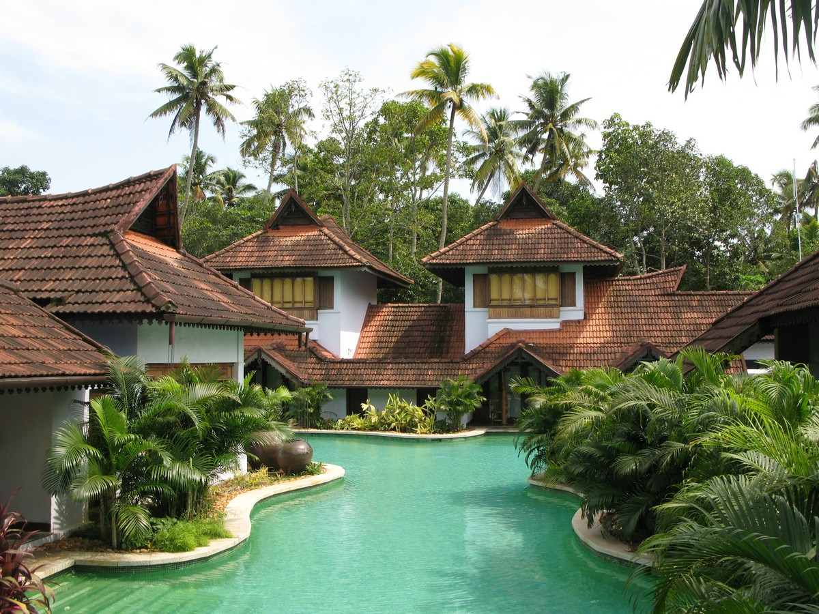

Slide 46
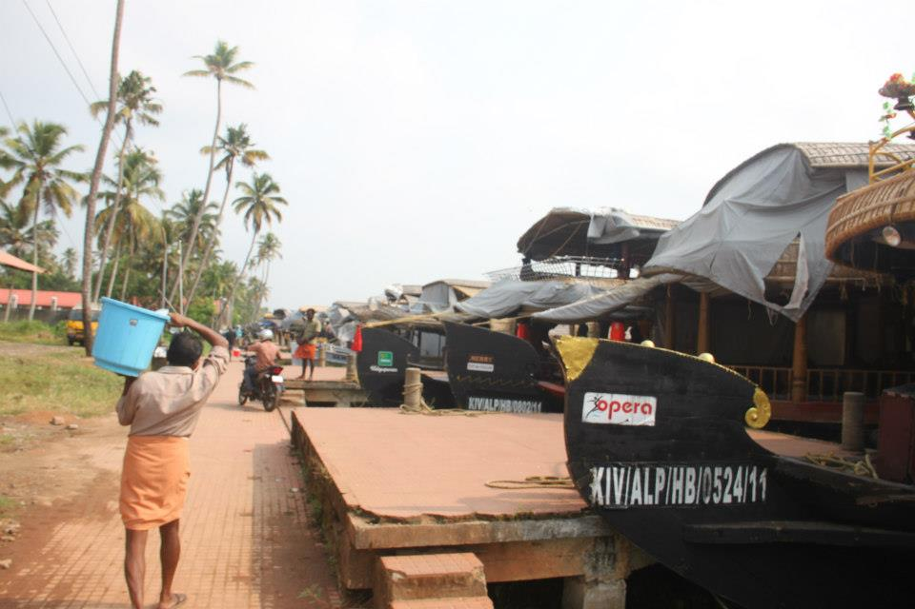
House Boat Tourism

Slide 47
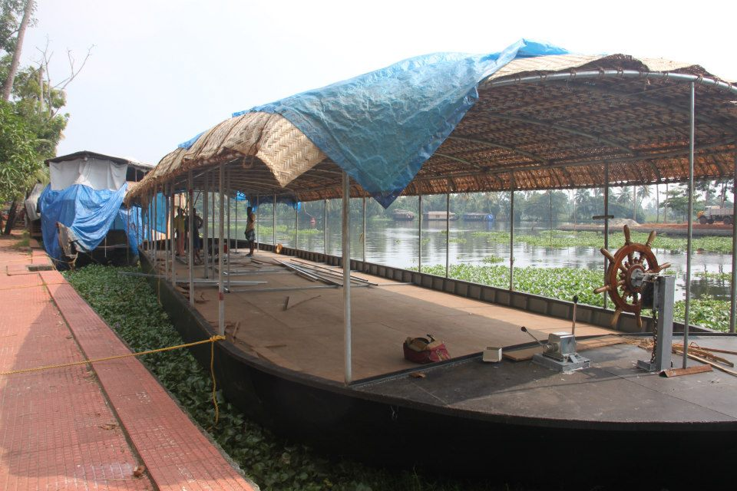
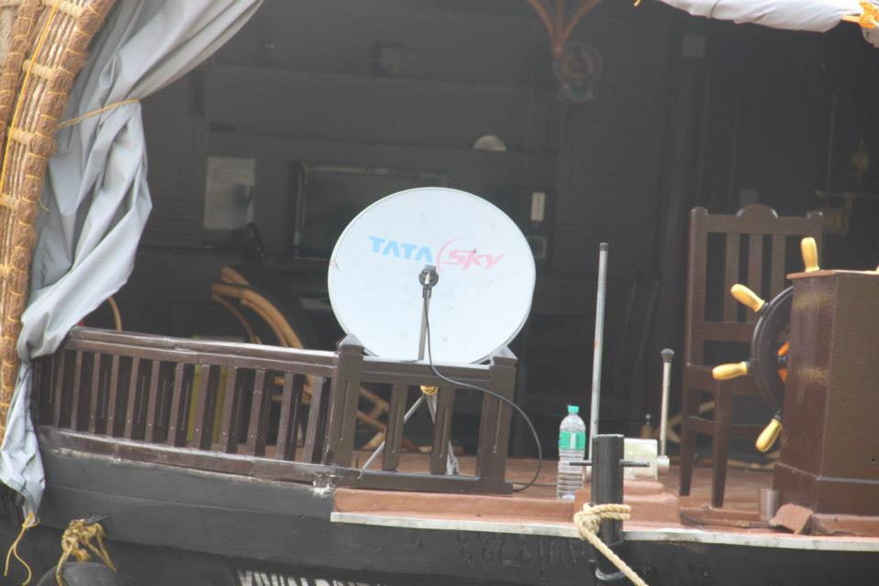
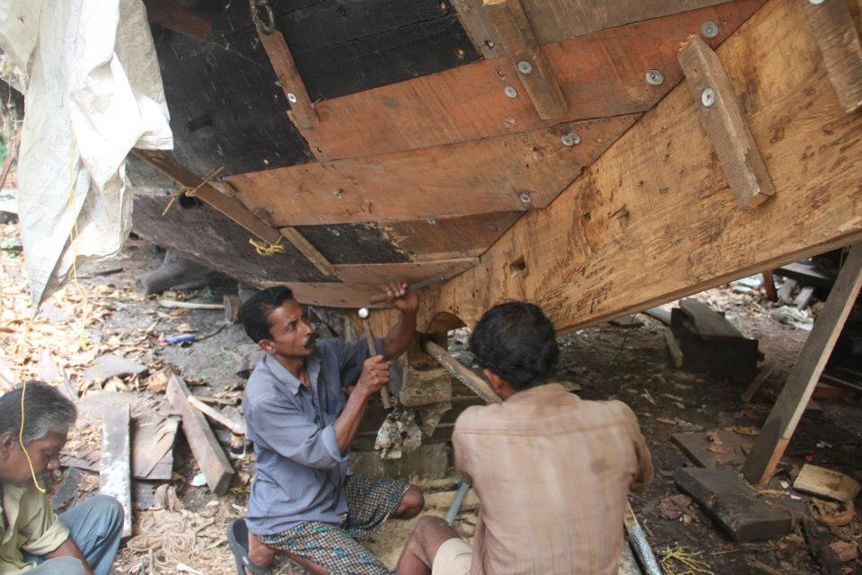
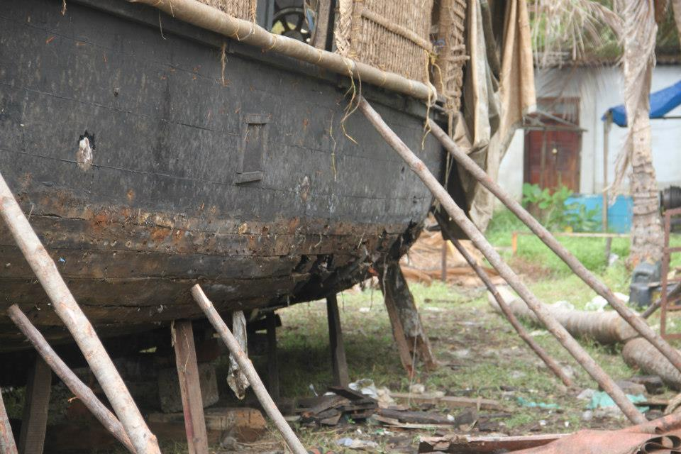

Slide 48
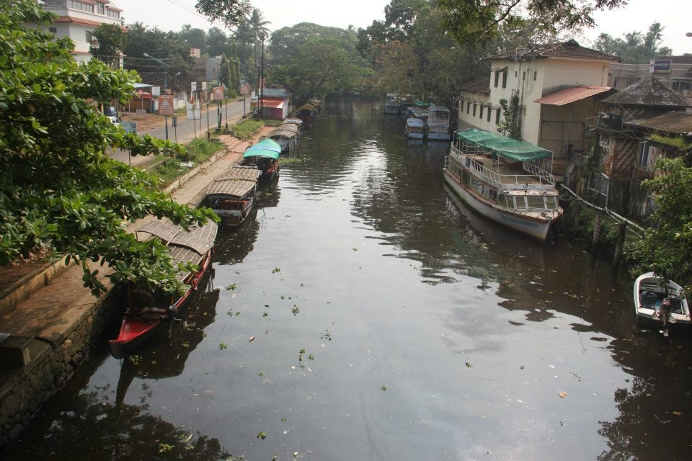
Benefits from HBs
1000 HBs in Alapuzha alone- 50% unlicensed
3000 permanent workers with Rs. 6850/ and daily allowance of Rs. 170/
Over 8000 indirect jobs
Rs. 70 lakhs/day of business around Alapuzha town

Slide 49
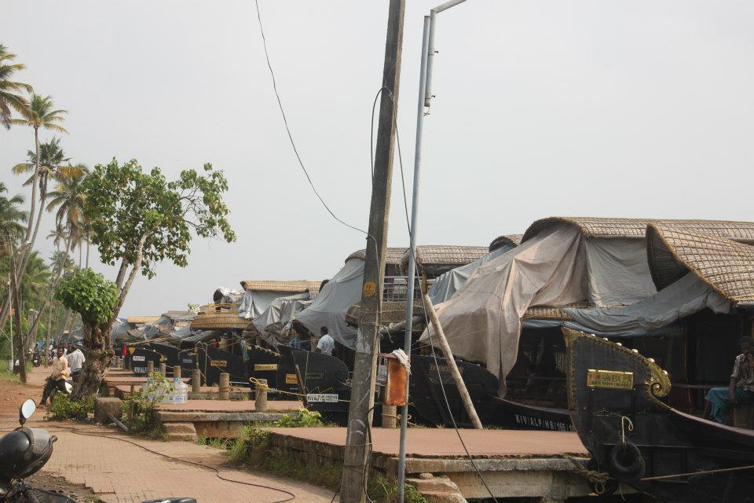
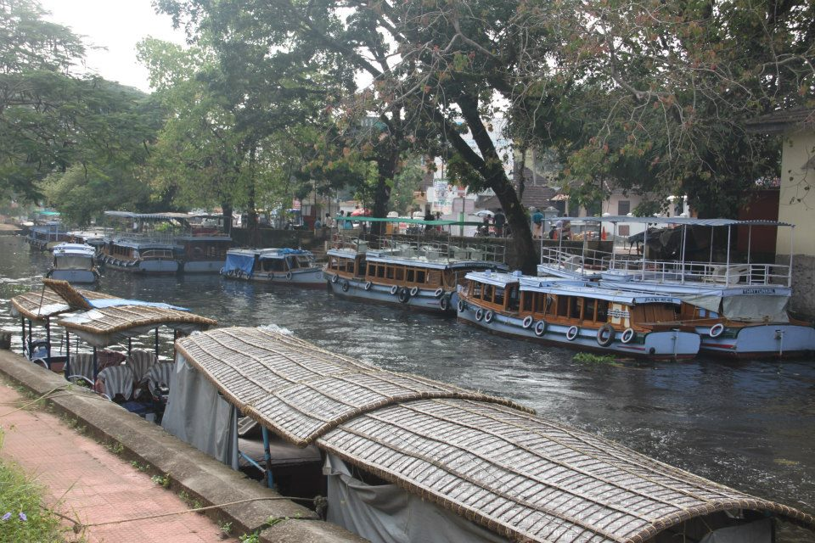
Crowded Canals

Slide 50
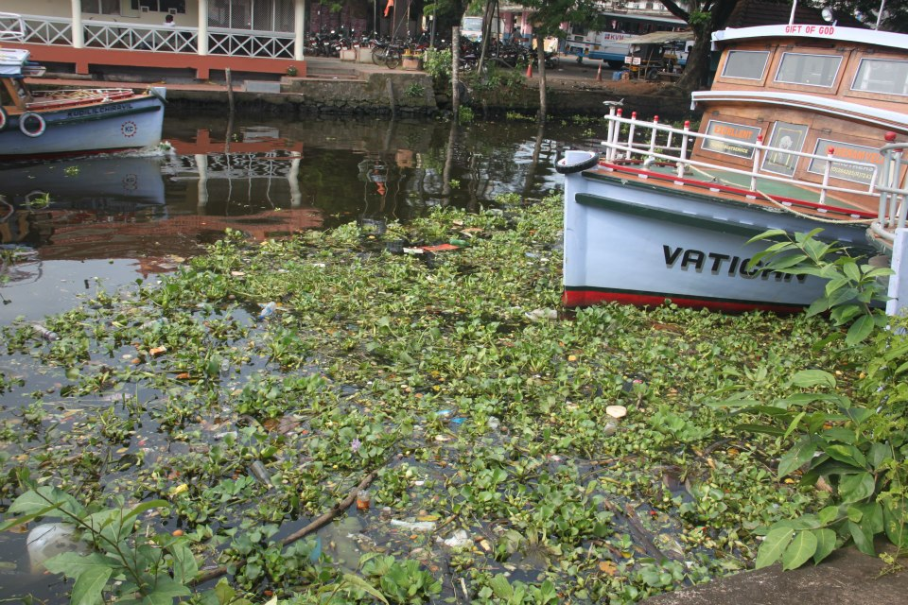
Pollution

Slide 51
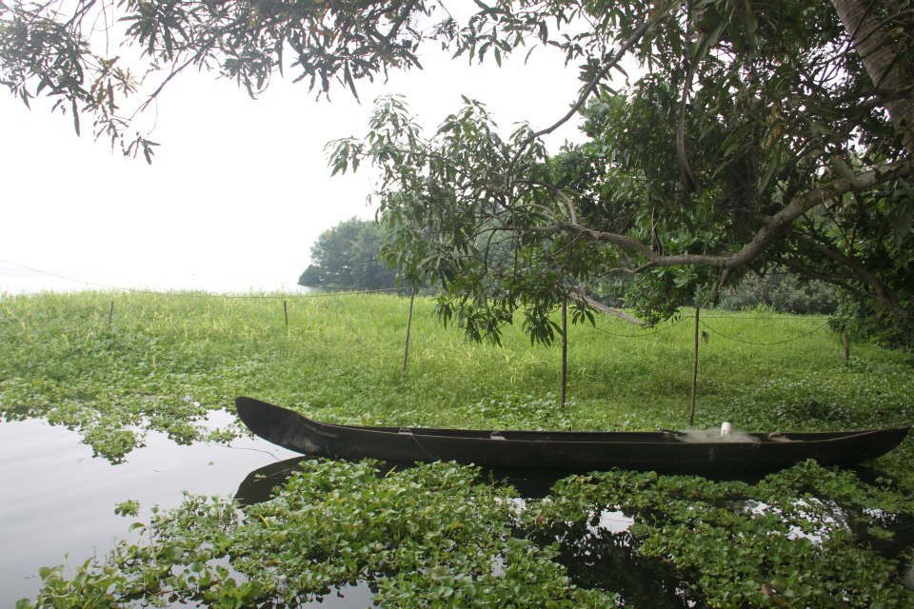

Slide 52
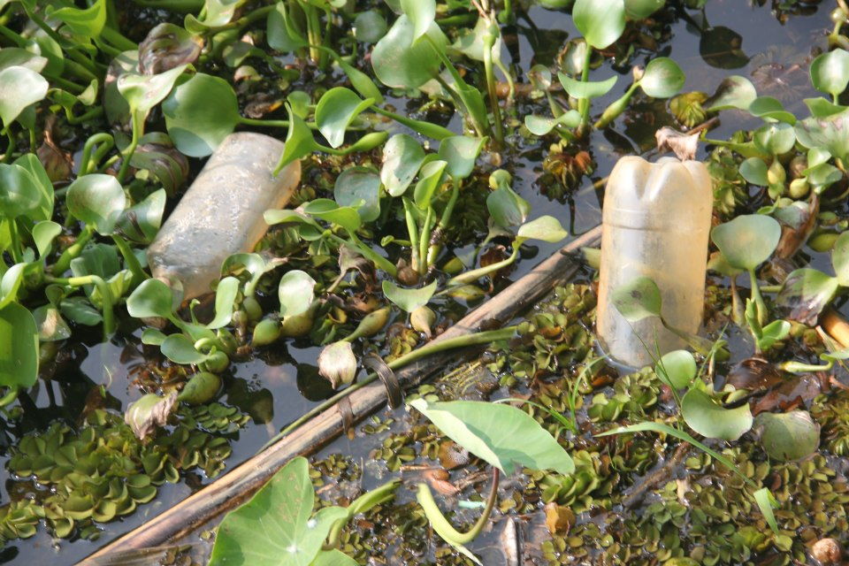

Slide 53
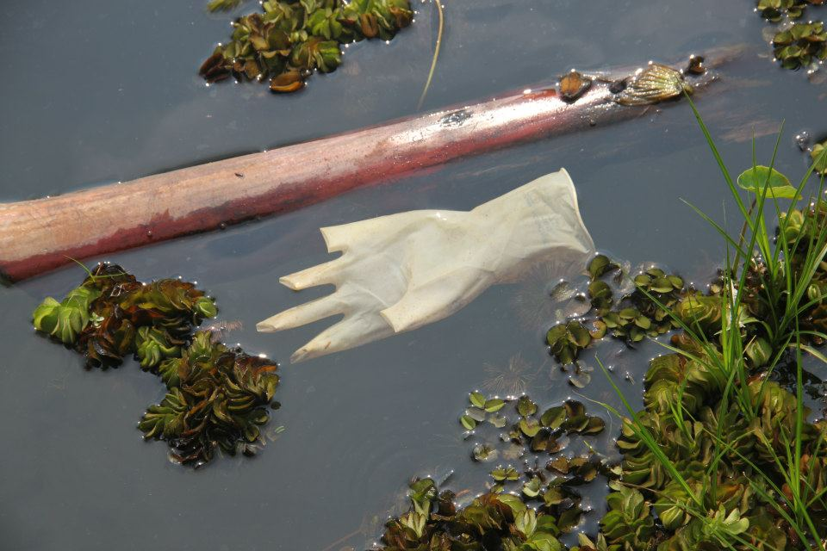

Slide 54
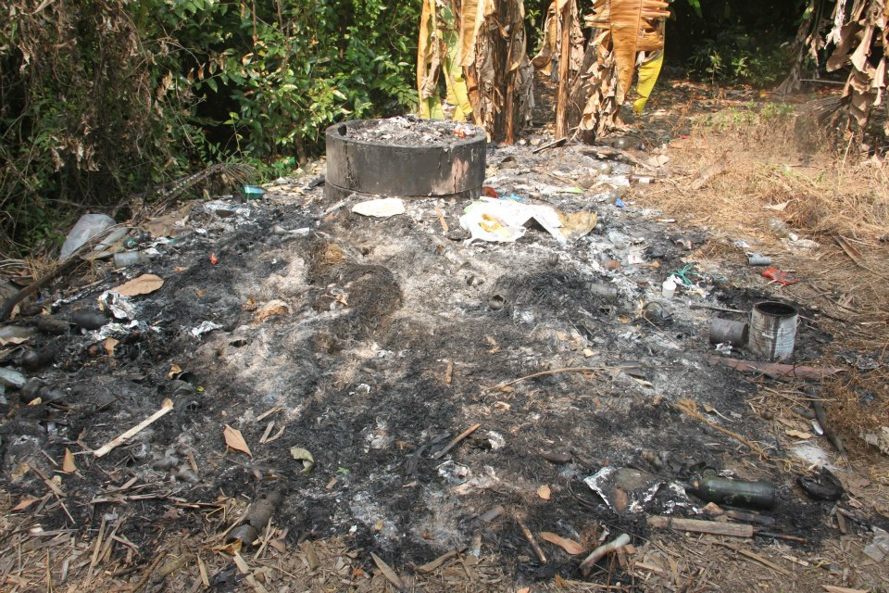

Slide 55
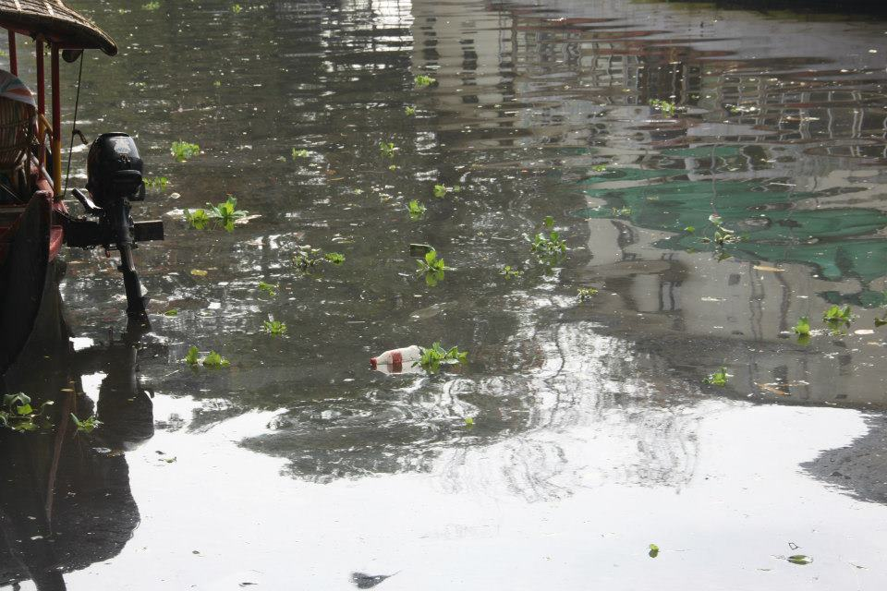
Pollution from House Boats (HBs)
507 licensed and almost equal number of unlicensed HBs
Liquid wastes per HB is 250 litres/room/day
Bio-toilets are compulsory, but not operated right
STP – faraway: sparsely used
New STP: 1 yr after construction NOT yet started
Mostly direct disposal
Some ‘honey sucking’ trucks-
But where does the waste go?

Slide 56
Legal / Regulatory Aspects
Environment Protection Act (1986)
Pollution Control Board : Water Quality Testing and Regulation of environmental issues
Unrealistic work load by PCB: Sanction of plan, compliance checking after construction & monitoring of norms of over 200 units Alapuzha alone.
Legal actions of hundreds of complaints
Along with this: issue/renew license of 1000 HBs in every two years and monitoring of compliance.
Clear that “policing” alone will NOT work

Slide 57
Larger Picture of Sewage/Industrial Pollution
1.6 million people on the banks of the lake in 38 panchayaths, three districts
Cochin (Kochi) Corporation and 3 municipal towns are on the banks
Kochi city generates 2550 mld of urban sewage enters the Vembanad
260 mld of industrial effluents
BOD values observed at Alleppey town are 15mg/l to 19mg/l showing increased level of organic pollution (should be less than 2 mg/L)
High coli form levels in the lake, especially during Sabarimala season through the Pampa river
Cochin shipyard and port release waste oil, paints, and metal and paints

Slide 58
Reflections on Political Ecology
Who Benifitted?
Progressive ‘capitalisation’ of nature
“Enclosure of Commons’ by powerful – with State patronage who later benefitted by policies of GR
Continued nexus of engineer-contractor-politician threatening the sustainability of the region with bund and road building
Exited or Shifted to House Boat Industry
Rent-seeking officials that benefit from non-compliance of Environment protection Act

Slide 59
Reflections on Political Ecology
WHO LOST by Environmental Degradation?
Agriculture became unviable after land reforms/simple reproduction squeeze of green revolution. Farmers exited, but agricultural laboureres suffer
“Ecosystem people” who directly depend on Lake– fishers due the pollution by HB, urban and industrial effluents.
Less Exit possibilities to lack of access to assets or education due to a historical dependence on commons.

Slide 60
Paradigm Shift Needed
Economy
Society
Environment

Slide 61
Thank you

Slide 62
Preliminary Thoughts on ‘Solutions’
Limitations of academic studies leading to change or thru’ regulatory institutions
Need more ‘outreach’ activities
Trans-disciplinary understanding by engaging students to the local context
Large number of students doing analysis of local environmental/resource use as part of curriculum
Thus instilling transparency, accountability by participation of these ‘student citizens’ in local level issues
Continuity through committed teachers of local academic institutions
This can strengthen NGOs / people’s movements who are lone voices now
Possibility of more regulatory powers to panchayats to ensure proximity and facilitate local transparency/accountability in environmental governance

